Slide 1
Quick Look: Variance Reduction at Scale
Improving IMC methods for thermal transport problems via a response function approach
Scott Campbell
Gonzaga University
Physics & Math-Computer Science

Slide 2
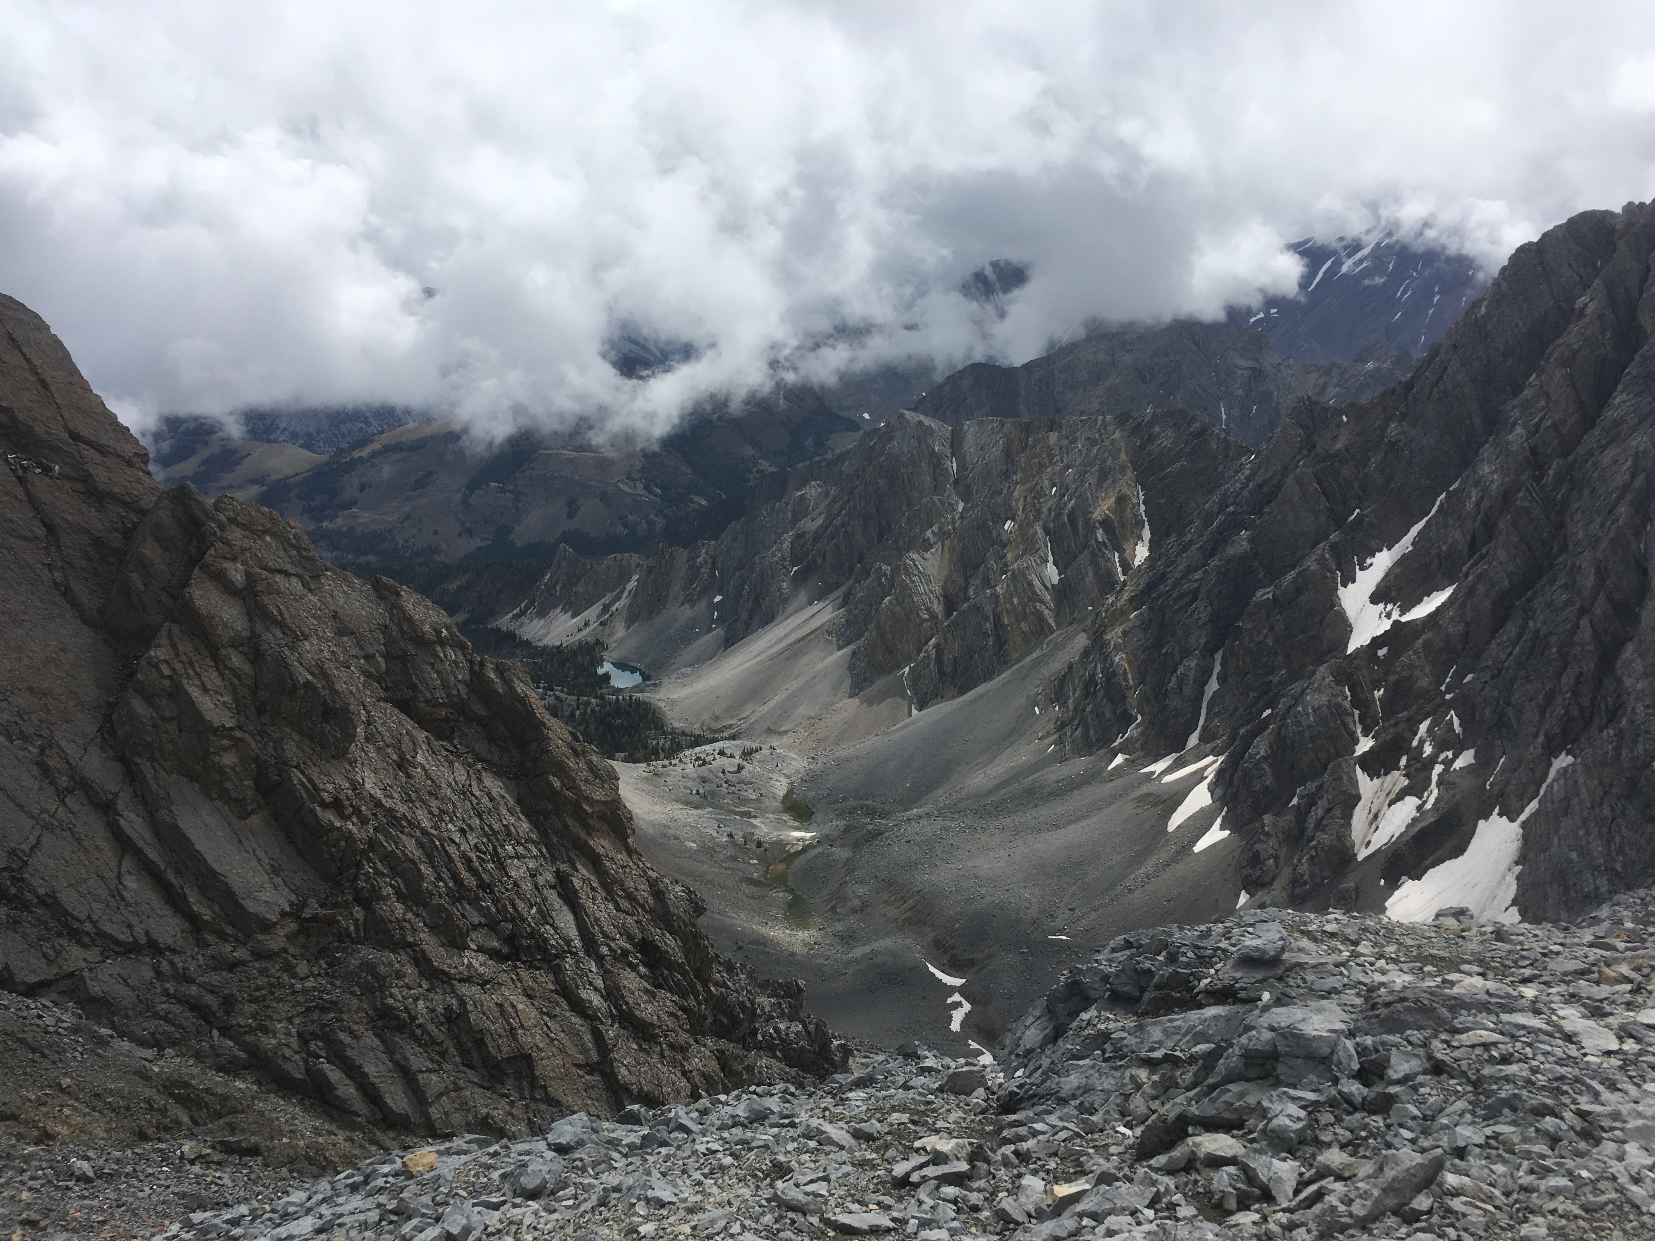
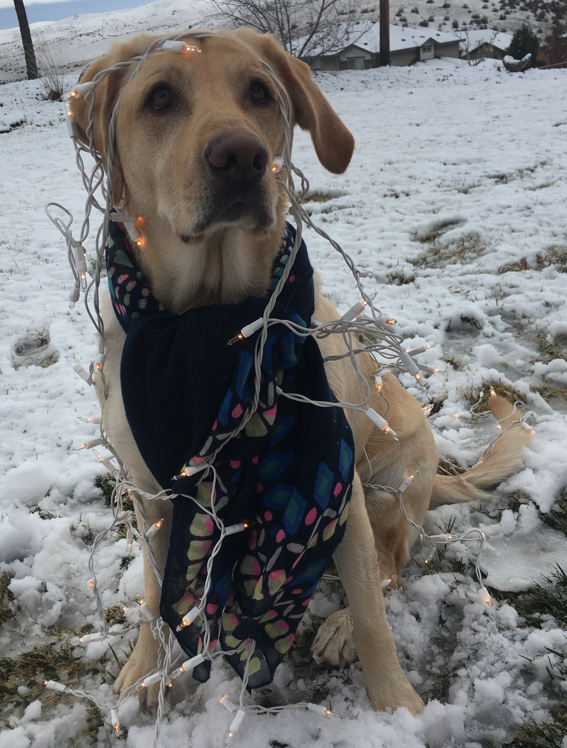
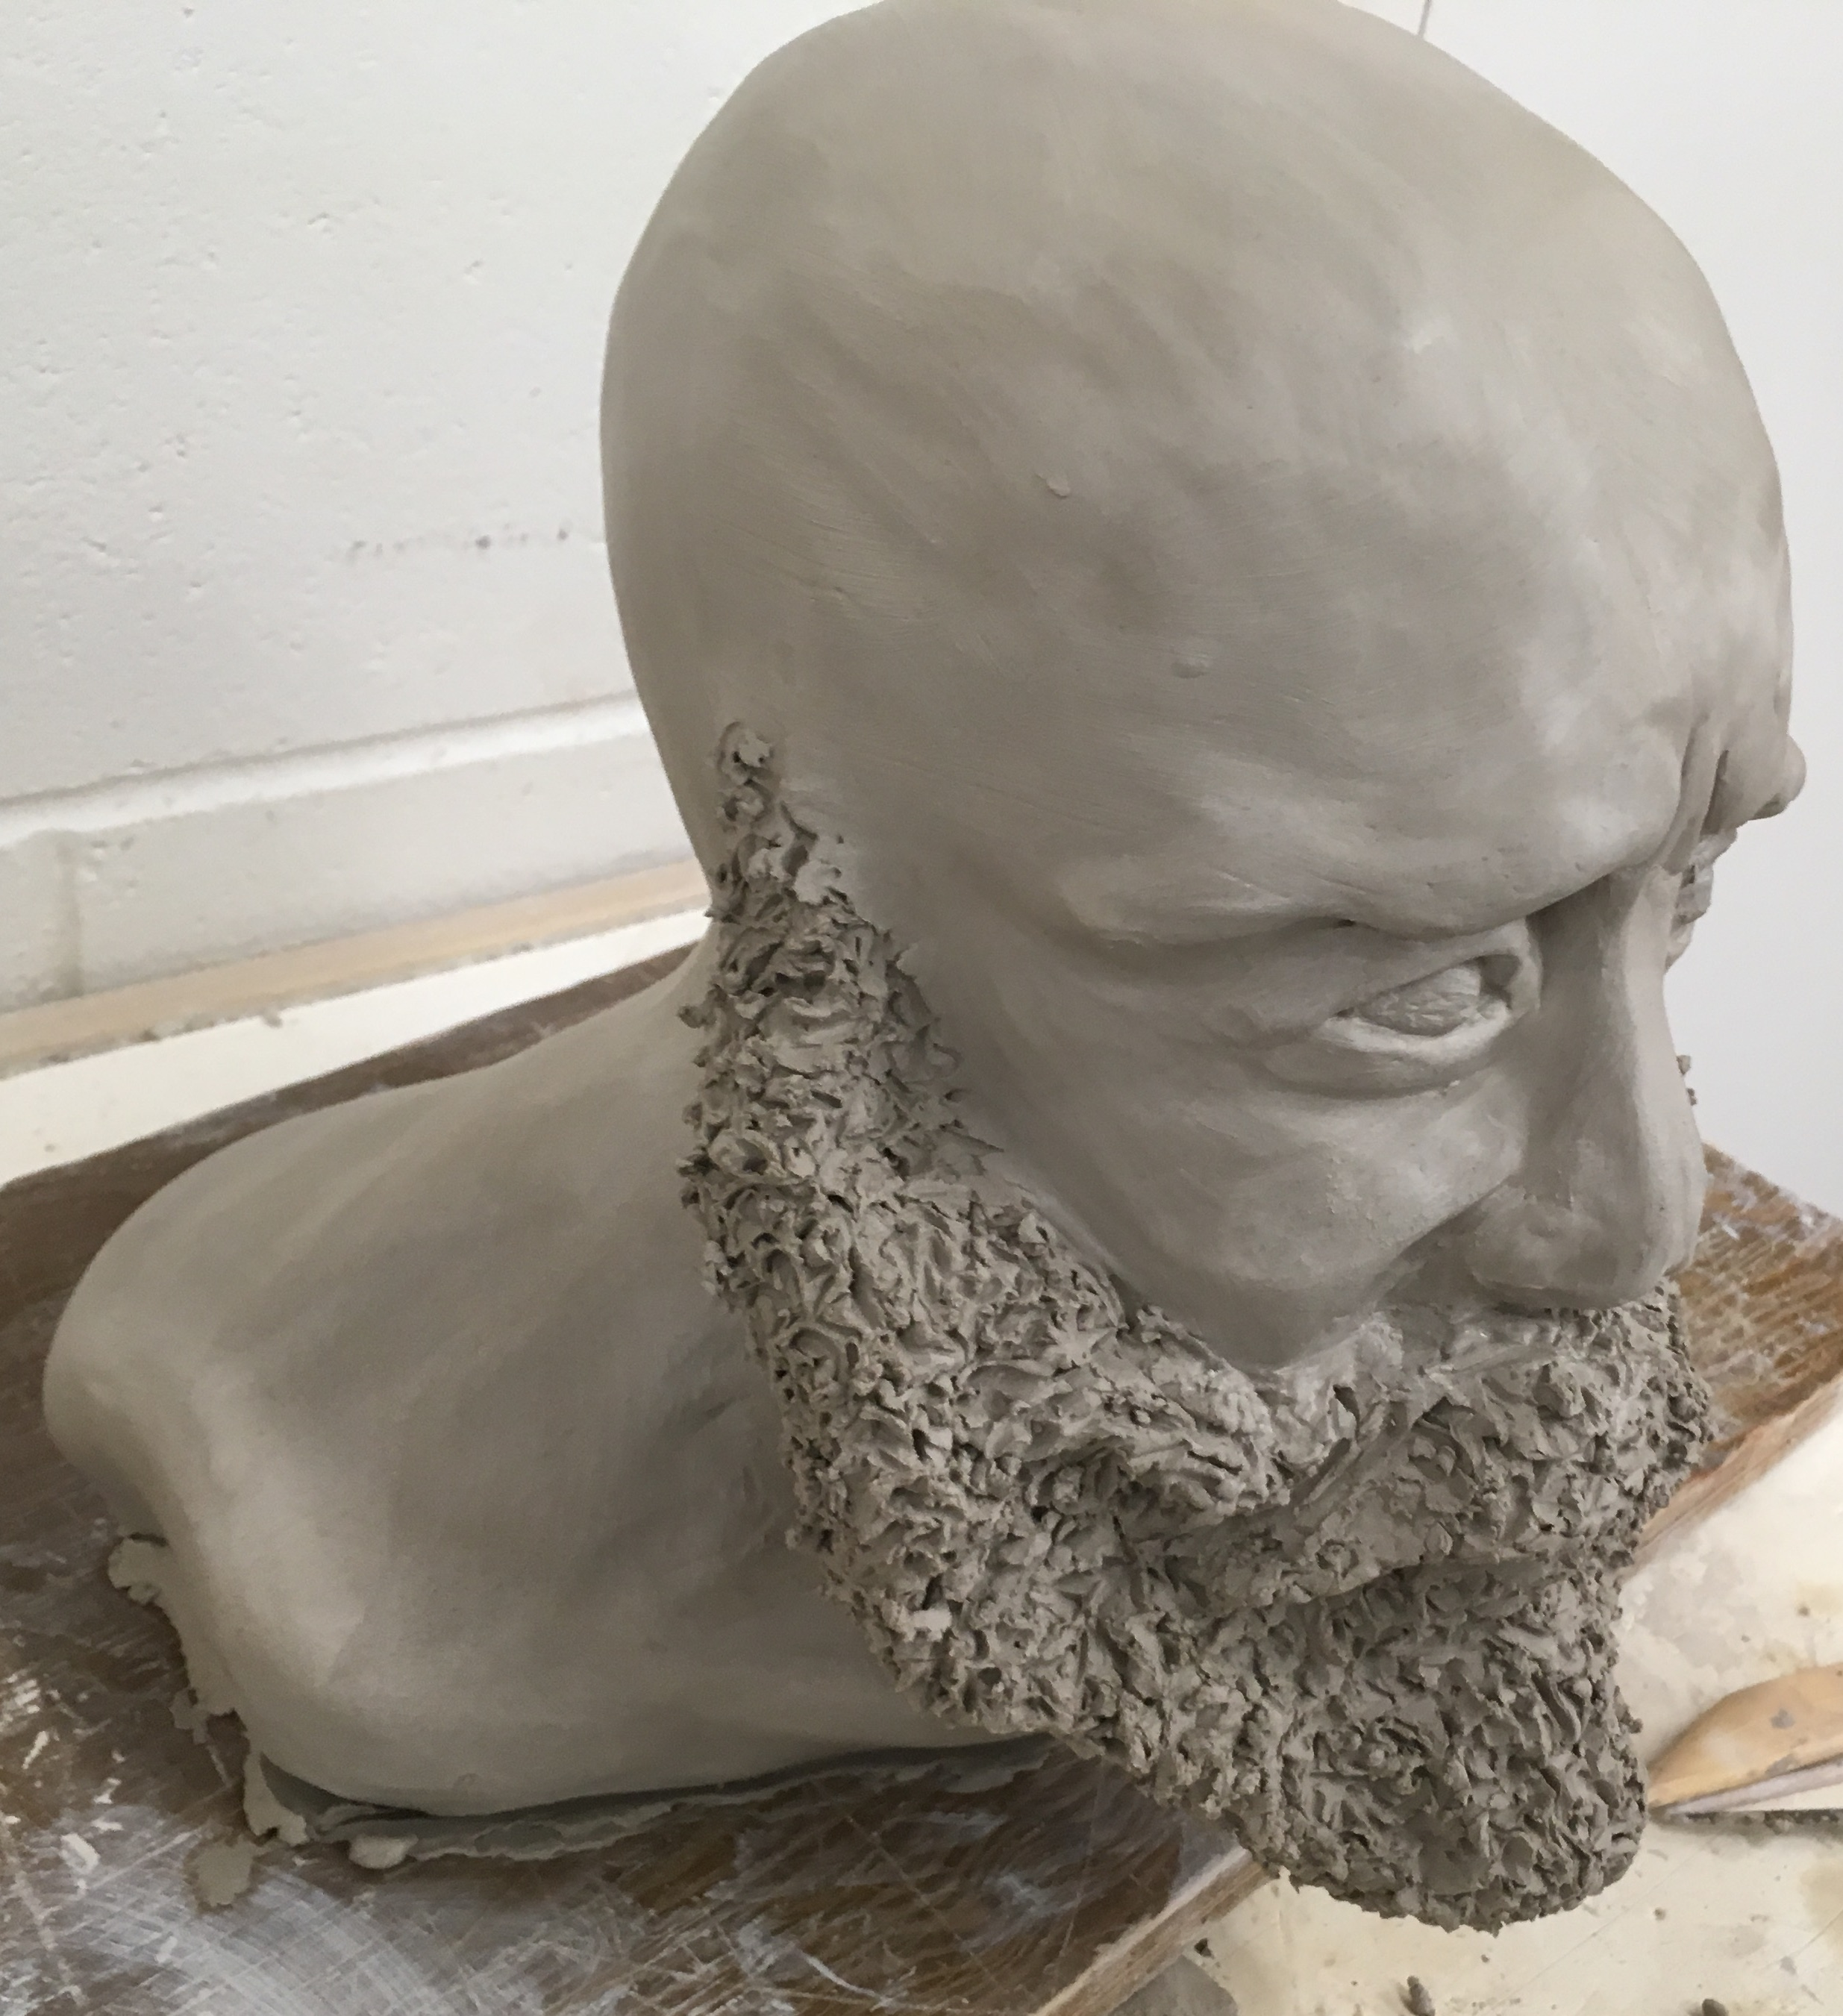
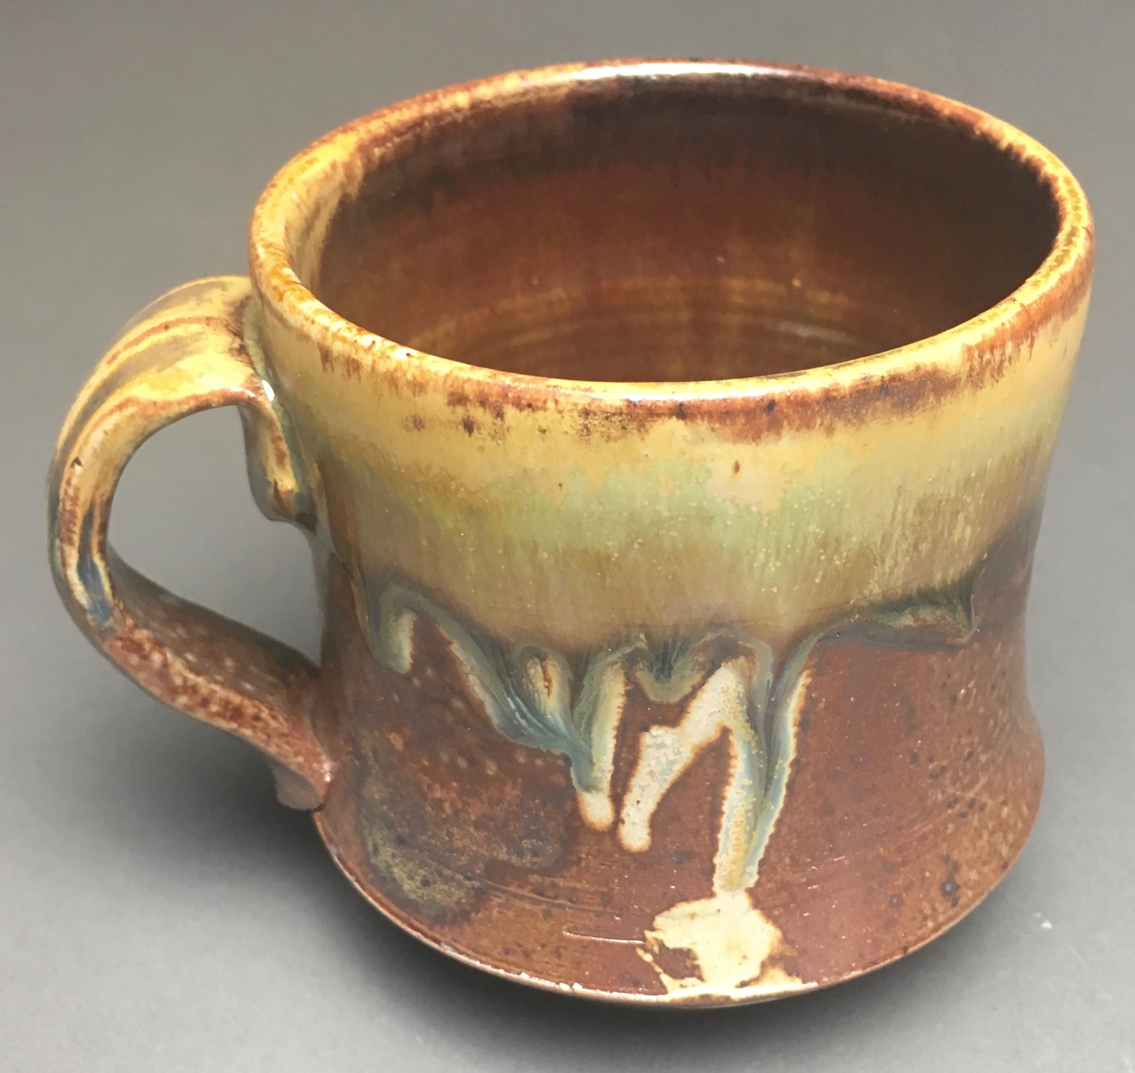
Background & Interests
Education, Work, and Research
Gonzaga Univ., Spokane WA
Physics & Math-Computer Science
Consultant for GroGuru Inc.
Established an async. RS-485 serial communication protocol variant for two indep. μCs via near field magnetic induction antennae
GSRP 2018 Summer Intern
Designed a cosmic ray muon detector advancing upon the MIT Cosmic Watch project
Capable of particle energy approx. and air-shower coincidence detection
AJP publication in review
Electrical Impedance Tomography
Cont. Fall 2019; Numerical Methods for PDE approx. for medical imaging technologies
My History and Interests

Slide 3
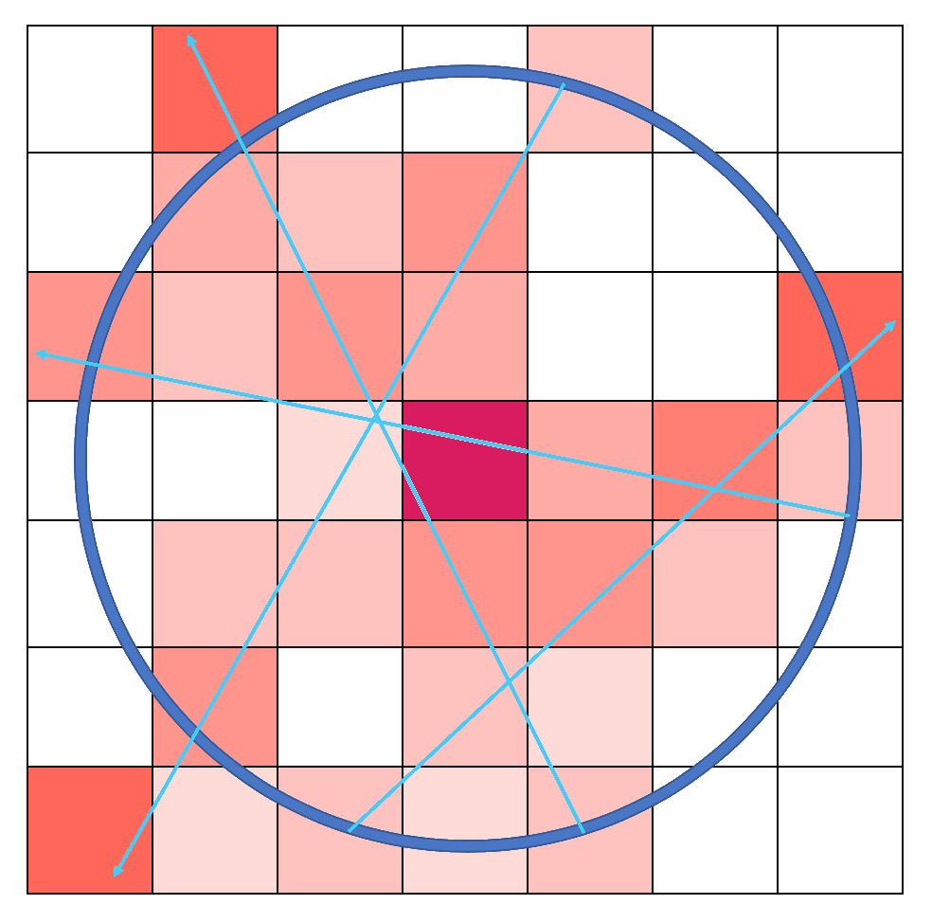
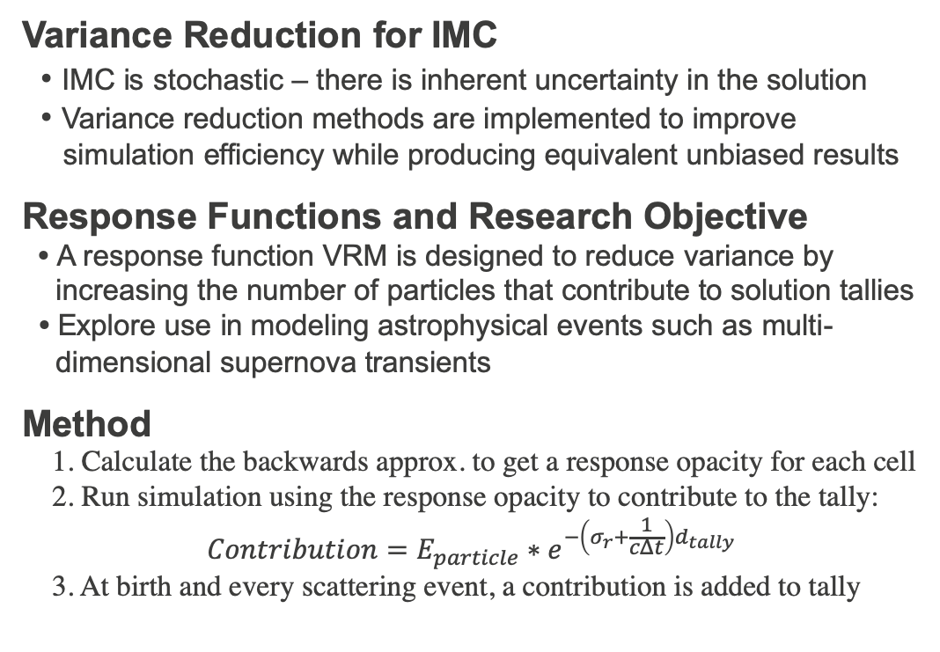
Background & Overview of Research
Variance Reduction for IMC
• IMC is stochastic – there is inherent uncertainty in the solution
• Variance reduction methods are implemented to improve
simulation efficiency while producing equivalent unbiased results
Response Functions and Research Objective
• A response function VRM is designed to reduce variance by
increasing the number of particles that contribute to solution tallies
• Explore use in modeling astrophysical events such as multi-
dimensional supernova transients
Method
1. Calculate the backwards approx. to get a response opacity for each cell
2. Run simulation using the response opacity to contribute to the tally:
$$\begin{aligned}Contribution=E_{particle}∗e^{−\left(σ_{r}+\frac{1}{cΔt}\right)d_{tally}} \#\#\end{aligned}$$
3. At birth and every scattering event, a contribution is added to tally
The Backwards Approx:
Particles are traced from the tally (blue) towards the source (purple). As they pass through the mesh, a ‘response value’ is calculated from a weighted average of all particles based on the distance they traveled and its weighted opacity from all cells it has passed through

Slide 4
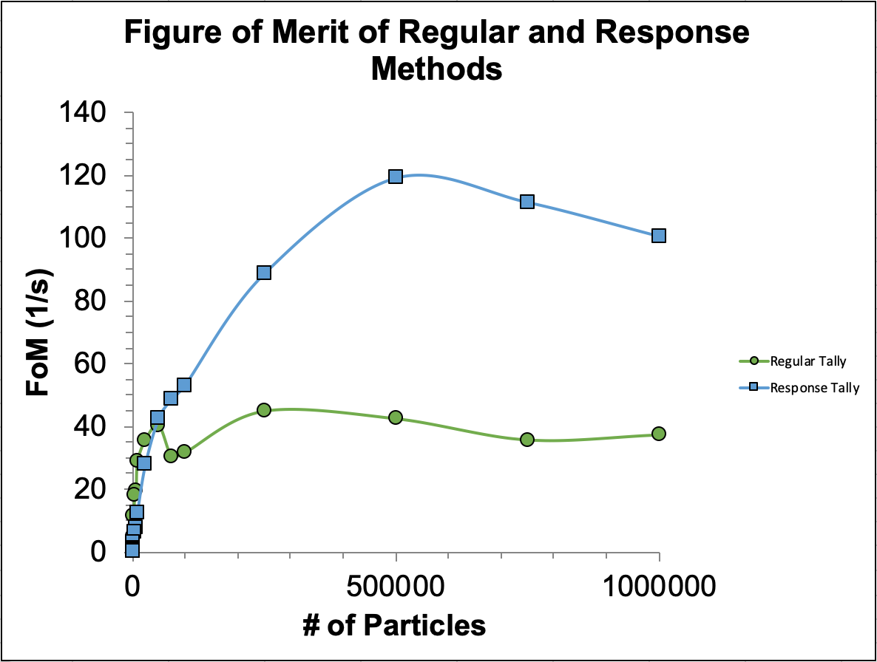
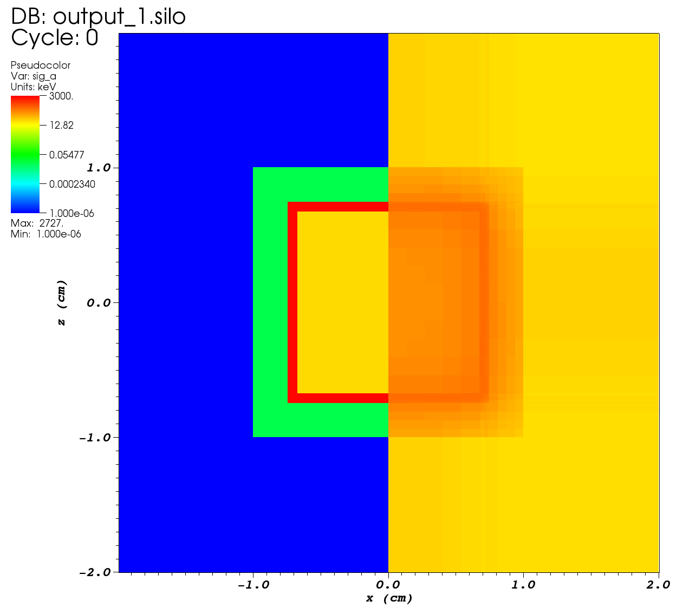
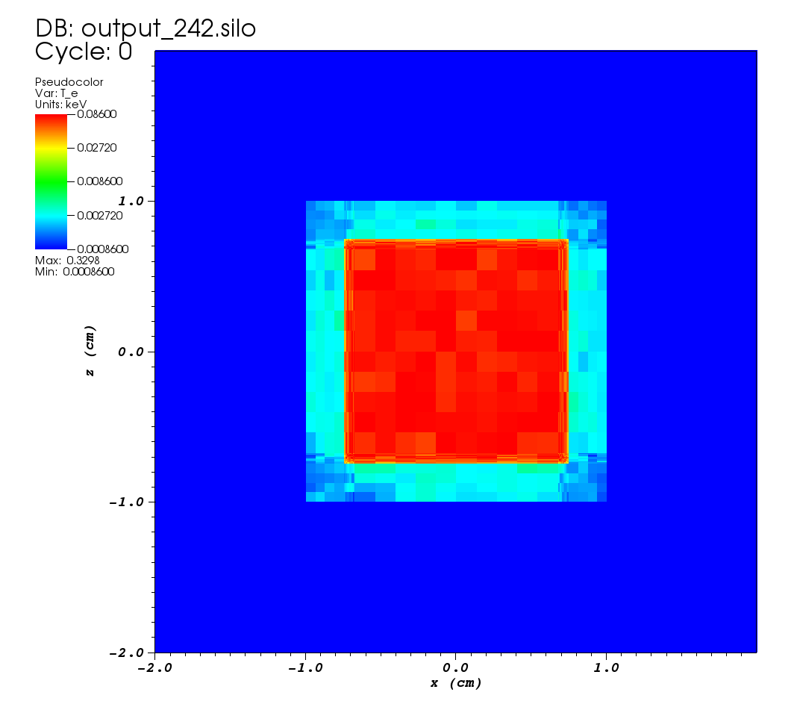
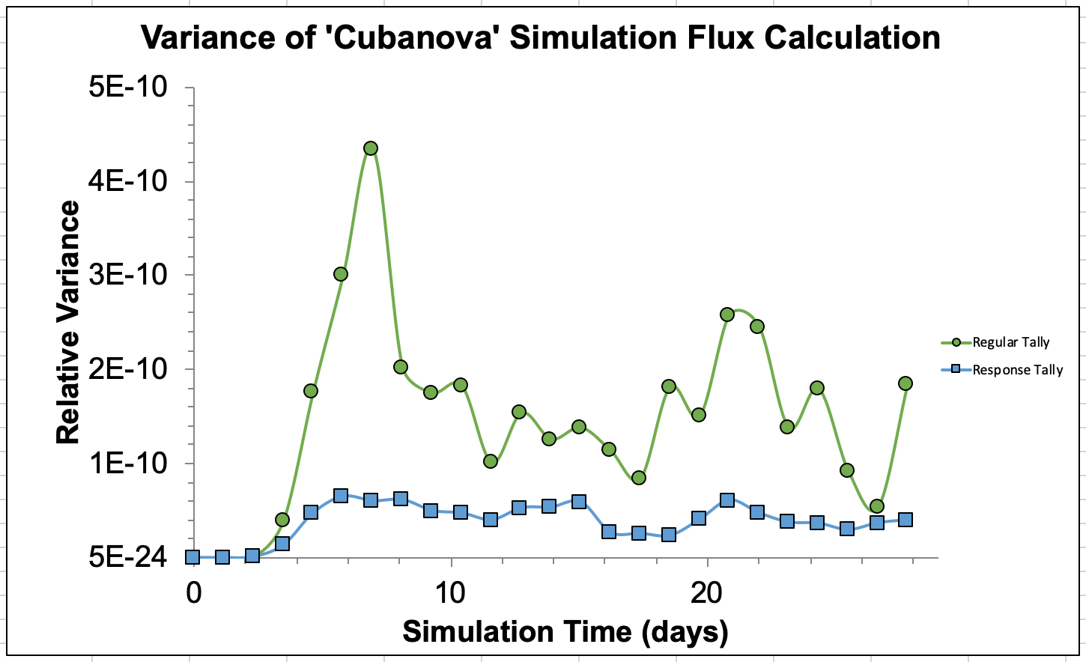
Results & Conclusions
Left Top:
Figure of Merit of the response function against a standard method. This shows that >50k particles, our method has far lower variance.
Left Bottom:
Rel. variance vs time of a supernova simulation. This also demonstrates our method results in a smaller variance.
Right Top:
Side by side of the true opacity vs the response value/opacity.
Right Bottom:
The electron temperature of the supernova at the end of simulation. Overheated regions likely result from small corner cells.

